Slide 1
FAIR ALLOCATION
Topic: Theory of Fair Allocation (Envy-Free)
- Cloud Federation in the Sky Course: B.Tech. Final Year Project(Part-1)
Prepared By:
B220088CS – ABHAY KUMAR BHARTI
B220736CS – ASHUTOSH RANJAN
B220589CS – VISHAL SONKAR

Slide 2
Understanding the Cloud Federation Problem
What is Cloud Federation?
Multiple cloud providers collaborate to jointly serve user requests.
Providers share resources: CPU cores, memory, storage, VMs.
A broker receives user requests and forms a federation to maximize profit.
The Core Problem
Providers have limited resources.
Not all providers can satisfy user requests alone.
Providers must cooperate to meet demand.
Challenges
How to decide which providers should form a federation?
How to ensure fair distribution of profit among participating providers?
How to maintain stability (no provider wants to leave)?

Slide 3
Components of the Cloud Federation
1. Cloud Providers
Each provider has:
N_{i}​: number of cores
M_{i}: memory capacity
S_{i}: storage capacity
c_{ij}: cost of offering VM type VM_{j.}
Providers want to maximize their individual profit.
2. VM Types
VM1 (small), VM2 (medium), VM3 (large), VM4 (extralarge)

Slide 4
Each VM has different:
CPU
memory
storage
price charged to user
3. Broker
Receives user VM request R= {r₁,r₂,...,r_{n}}
Selects a federation to serve the request
Handles billing: user pays fixed price p_{j} per VM type
4. Federation
A coalition of cloud providers that jointly serve the request
Goal: maximize total profit

Slide 5
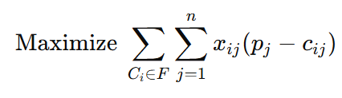
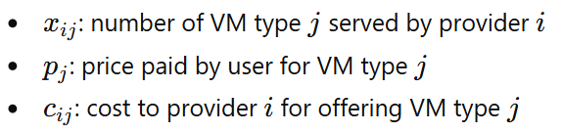
Mathematical Formulation of Profit Maximization
Objective Function
Meaning
xi: number of VM type j served by provider i
pj: price paid by user for VM type j
cij: cost to provider I for offering VM type j
Federation wants to maximize revenue minus cost

Slide 6






Key Constraints
Providers cannot exceed CPU limits.
Providers cannot exceed memory limits.
Providers cannot exceed storage limits.
Total VMs allocated = user’s request.
Each provider must contribute at least one VM.
Integer constraints on x_{ij.}

Slide 7
We solve for:
Inputs collected by broker:
Provider capacities : N_{i} , M_{i} , S_{i}
VM type resource demand : r_{j}
Price per VM : p_{j}
Cost per VM for provider : c_{ij}
VM resource requirements : w_{j​}^{c}, w_{j}^{m},w_{j}^{s}
Then broker runs the ILP solver to:
Assign integer VM counts x_{ij} to each provider.
Maximize total federation profit while satisfying all constraints.

Slide 8
Best ILP solvers
Commercial optimizers:
Gurobi
IBM ILOG CPLEX
FICO XPRESS
Open-Source ILP solvers:
SCIP
GLPK
COIN‑OR CBC
Library-based modeling (broker can implement via code):
Google OR‑Tools
PuLP
Pyomo

Slide 9
Why the Grand Federation is Not Always Stable
Grand Federation = all providers together
But may be unstable because:
Some providers may earn less profit when merged
A provider may benefit more by working alone or with fewer partners
If one provider wants to leave → the federation collapses
Example
Providers {C1, C2, C3}
Profit values show some coalitions perform better than grand coalition
If a provider earns less in the grand coalition → instability
Conclusion
➡ Need a mechanism that lets providers self-organize into stable federations.

Slide 10

Introducing Hedonic Games
Why Hedonic Games?
Providers prefer coalitions based on their own profit, not global profit
Preference depends ONLY on the members of the same coalition
Preference Rule
Meaning
Provider i prefers federation F over F′ if it earns more profit in F
Why Hedonic Model Works
Natural: cloud providers behave selfishly
Local decisions → global stable structure
Eliminates need for central controller

Slide 11


Cloud Federation Formation Mechanism (CFFM)
This mechanism is built using hedonic game theory and works through merge and split operations among providers.
Step 1 — Start Alone
Each cloud provider begins as its own federation: {C1​},{C2​},{C3​},…
Step 2 — Check Profit
Each provider compares:
Profit in current federation
Profit if it merges with others
Profit if it splits
Using preference rule:
Provider prefers the coalition that gives higher profit.
Step 3 — Merge Rule
Two federations merge if every member gains more profit:

Slide 12

Step 4 — Split Rule
A federation splits if any member gains more profit by splitting:
Step 5 — Repeat Until Stable
Merges and splits continue until:
No merge can benefit everyone
No split can benefit anyone
The final coalition structure is stable.
Ensuring Fair Profit Sharing (Banzhaf Value)
Problem
After forming a federation, how do we split total profit fairly?

Slide 13

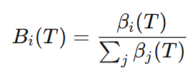

Solution: Banzhaf Power Index
Measures the marginal contribution of each provider
Fair: providers who contribute more resources get more profit
Definition
Normalized Banzhaf:
Payoff:
v(T) = total coalition profit.
B_{i}(T) = Measures how important provider iii is for coalition T.
ψ_{i}(T) = profit provider i actually gets.

Slide 14
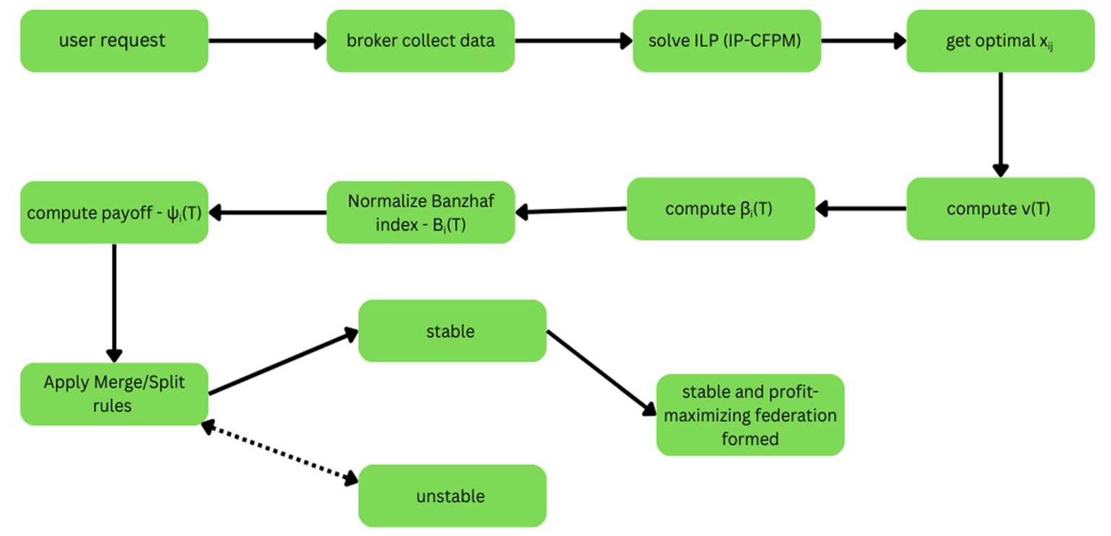

Slide 15
Final Outcome: Stable Cloud Federation
Properties of the solution
Fair: based on Banzhaf power
Stable: no provider wants to leave its coalition
Efficient: meets user demands with optimal profit
Decentralized: providers decide based on their individual preferences
Scalable: avoids trying all Bell-number partitions
Result
➡ System converges to a stable set of federations ➡ Maximum possible satisfaction and profit distribution ➡ Cloud marketplace functions smoothly

Slide 16

Mapping Cloud Federation to Envy-Free Fair Allocation (EFX)
Cloud Federation Problem
Providers collaborate to serve a VM request.
Must split total profit fairly among providers.
Providers compare coalitions based on their own payoff.
Goal: reach a stable coalition where no one wants to leave.
1. Items ↔ Profit
In EFX, items are allocated.
In federation, total profit v(T) is allocated.
Profit is the “resource” being fairly divided.
2. Agents ↔ Cloud Providers
Each cloud provider = an agent with preferences.
Preferences depend on payoff:

Slide 17
3. Fairness Criterion ↔ Envy-Freeness
Federation uses Banzhaf-based payoff:
This ensures no provider envies another:
Providers get pay proportional to marginal contribution → envy is minimized, similar to EFX fairness.
4. Stability ↔ EFX + Pareto Efficiency
Pareto Efficiency: No other allocation of providers can give all of them higher payoff simultaneously.
Merge & Split rules ensure:
No beneficial merge exists → Pareto optimal.
No beneficial split exists → no provider envies another coalition.
Final federation = Pareto-efficient + envy-reduced allocation, like EFX solutions.

Slide 18
⭐ Conclusion
Cloud federation is equivalent to EFX-style fair allocation: Providers (agents) share profit (items) using Banzhaf fairness (envy-free), and merge–split stability ensures Pareto efficiency.
References:
Handbook of COMPUTATIONAL SOCIAL CHOICE.
Cloud Federation in the Sky : Formation Game and Mechanism
https://ieeexplore.ieee.org/document/6853386
EFX using SAT https://www.ifaamas.org/Proceedings/aamas2025/pdfs/p510.pdf

Slide 19
THANK YOU!

